Slide 1
Training on ITS
WordPress CMS Service
Gripen Kwok / Steven Man
9 Dec 2022

Slide 2
About Us
Gripen Kwok
Email: gripen@hku.hk
Tel: 3917 2455
Steven Man
Email: manwk@hku.hk
Tel: 3917 6230

Slide 3
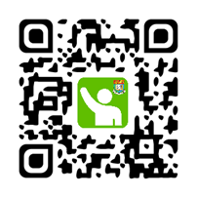
Welcome to WordPress Training
Be ready to START:
Please check in with Attendance@HKU, and
get the ticket
Find any available seat , no password is required
Use Chrome to access https://wpcms-its.hku.hk/training-session/, view or download the embedded PDF
Visit your demo site: https://wpmockupXX.hku.hk/wp-admin/, XX is the ticket number.

Slide 4
Agenda
Introduction to WordPress CMS service
Login to WordPress demo sites and get started
Install WP plugins and themes
Edit page
Create pages that require access control by using HKU Portal accounts
Menus, and configure WP Settings
5.8 new features
Hand-on exercises
Q&A

Slide 5
Introduction

Slide 6
About WordPress
A content management system (CMS) is a software that facilitates creating, editing, organizing, and publishing content. WordPress is a Content Management System, that allows you to create and publish your content on the web.
Free and open-source Content Management System (CMS) written in PHP [GPLv2+]
First release on May 27, 2003
33.6% of the top 10 million websites
There are tons of online resources, more than 3,000 themes and 50,000 plugins are available for developing projects on WordPress

Slide 7
Objectives
Reduce the cost and manpower in managing the WordPress platform, so that users can concentrate on the web content creation and management
An intuitive interface for users to create & maintain a website without knowledge of web programming
ITS will be the gatekeeper of the WordPress CMS core and will maintain and enhance the platform with ongoing update

Slide 8
What’s ITS WordPress CMS Service
In-house WordPress CMS is based on RedHat OpenShift Container Platform
WordPress 6.0.3 with PHP 7.4.6 MariaDB 10.2.22
Webmaster can install the themes and plugins
10 GB capacity for each site (Included both web and database)
Integrate with HKU Portal to enable Single Sign-On
  Sign in by HKU Portal UID and PIN to start content creation;
  Protect any restricted using HKU Portal authentication
At least 10 quotas of WordPress sites are available free for each department

Slide 9
How to start a webpage using WordPress CMS
Submit CF83
Select “new WordPress site” under "Application type”
Then given the following information inside the form:
- Domain name XXXXX.hku.hk*
- Name of your website
- HKU Portal UID of your site administrator
* As WordPress CMS uses HKU wildcard SSL certificate with WAF, the domain name will be limited to “XXXXX.hku.hk”. If applicants who want to make use of other domain, you should apply your own SSL certificate and key (via CF36).

Slide 10
Login and get started

Slide 11
Access the admin dashboard
Visit your demo site: https://wpmockupXX.hku.hk/wp-admin/, XX is the ticket number.
The demo site will be kept for 2 week, you can feel free to test it within these 2 weeks (23 Dec 2022).
Please login within HKU network or via HKUVPN
It will redirect you to HKUPortal for authentication.
Login dialog can be shown upon request.

Slide 12
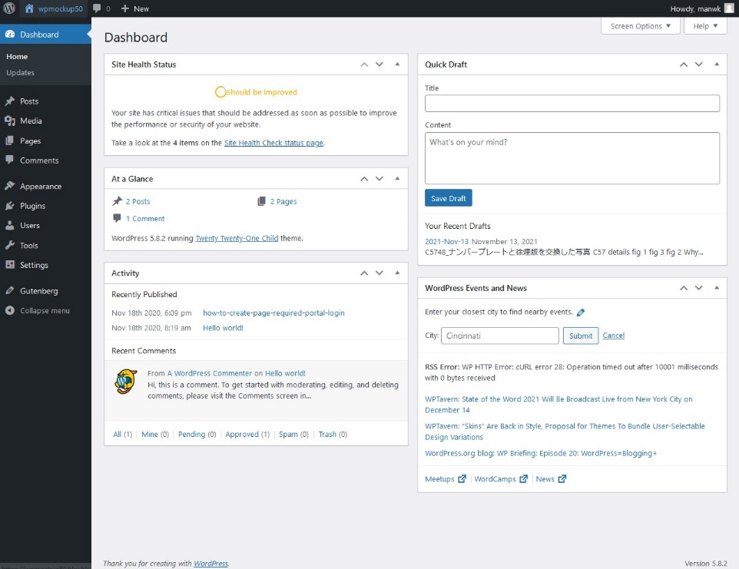
Lab Practices
1. Access your main site from a web browser
  https://wpmockupXX.hku.hk/wp-admin/,
  2. Login HKU Portal with your HKU Portal UID and PIN
After logging into the WP Dashboard, the main page is shown

Slide 13
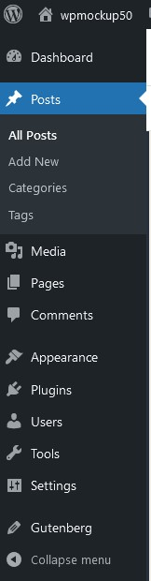
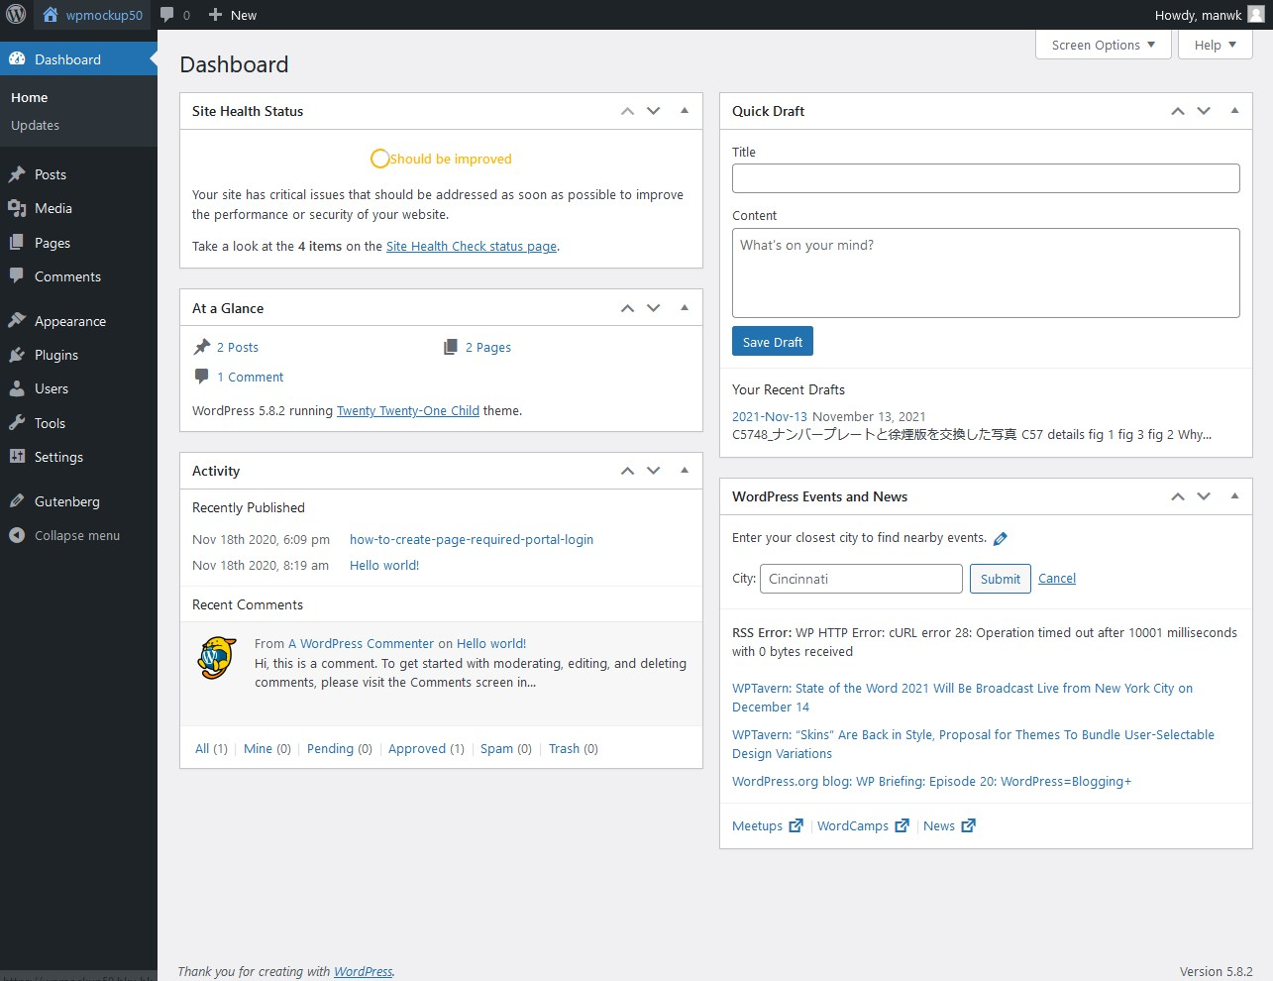
WP CMS Dashboard
Main Navigation Menu

Slide 14
Dashboard
Section
Posts | Manage posts
Media | Media files and attachments
Pages | Manage pages
Comments | Manage comments
Appearance | Manage themes, widgets, menus
Plugins | Manage and install WP plugins
Users | View and manage WP users
Tools | Plugins settings
Settings | Various WP settings, plugins settings
Notes:
Categories vs Tags: The easiest way to understand the difference between category and tag is to imagine your website is a book. Table of contents found in a book defined the broad sections available in a book. Category in a WordPress website can be thought of as a table of content in a book. Similarly, index found at the back of the book can be thought of as tags in a website. As a good practice, try to assign one blog post to not more than 3 categories. You can be bit leberal with tags. A blog post can be assigned to as many meaningful tags as you wish to.
Posts vs Pages, post is generally used for blogs and are published at regular intervals while page is used for static articles

Slide 15
Add new users
User log in via Single Sign-on (SSO)
The delegate can then login the WordPress site via HKU portal without extra password.

Slide 16
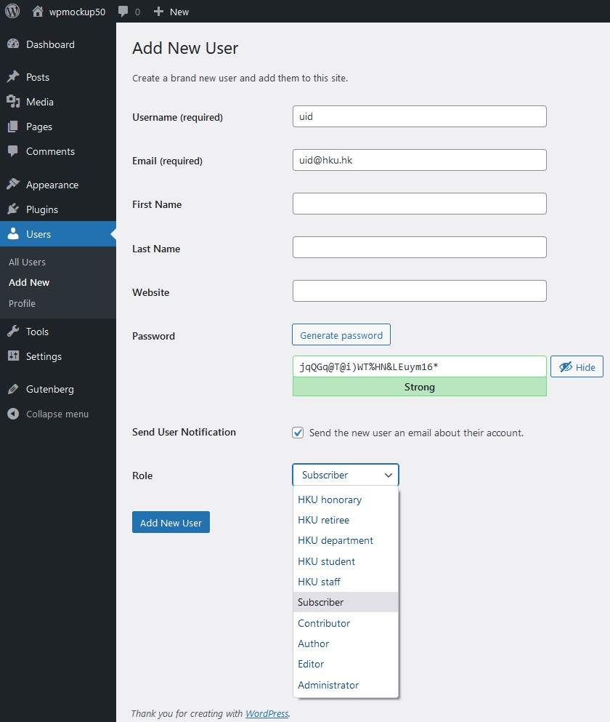
Add new users
1. Select Users
3. Enter UID
4. Enter email address
2. Add New
5. Select User’s Role

Slide 17
Add new users – User Role
Administrator – access to all the administration features within a single site.
Editor –publish and manage posts including the posts of other users.
Author –publish and manage their own posts.
Contributor –write and manage their own posts but cannot publish them
Subscriber – read posts

Slide 18
Add new users – 5 HKU custom Roles
5 HKU custom roles, which are assigned and updated when user login via HKU Portal. You don’t need to and cannot update the role. It is used for SSO-protected page . The HKU custom roles can co-exist with any other WordPress roles
HKU staff
HKU student
HKU department - departmental account
HKU retiree
HKU honorary

Slide 19
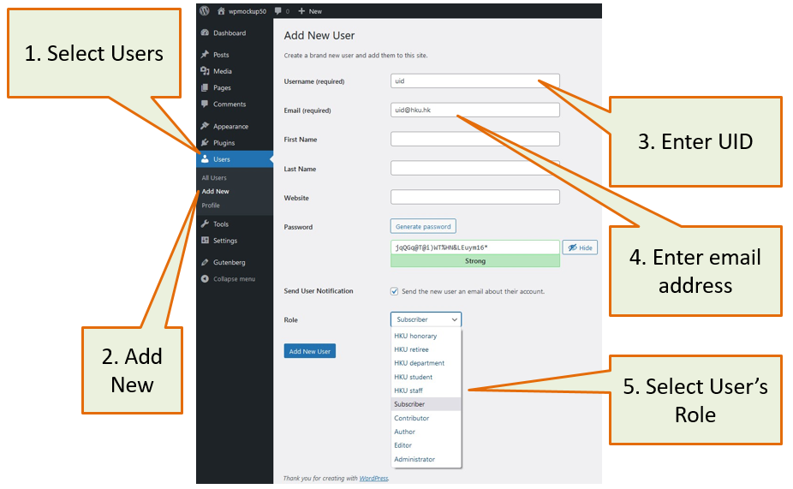
Lab Practices - Add New User and Grant User Role for accessing WP Page
Click ‘Users’
Select ‘Add New’
Enter UID of the delegate as username
Enter his / her HKU email address (UID@hku.hk for staff and UID@connect.hku.hk for student) in the email session
Select user ‘Role’ per your requirement.

Slide 20
Install WP plugins and themes

Slide 21
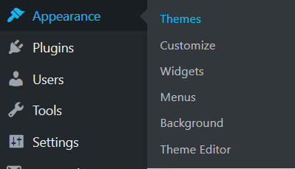

Install WP Themes
1. Mouse over Appearance
2. Select Themes
3. Click Add New

Slide 22
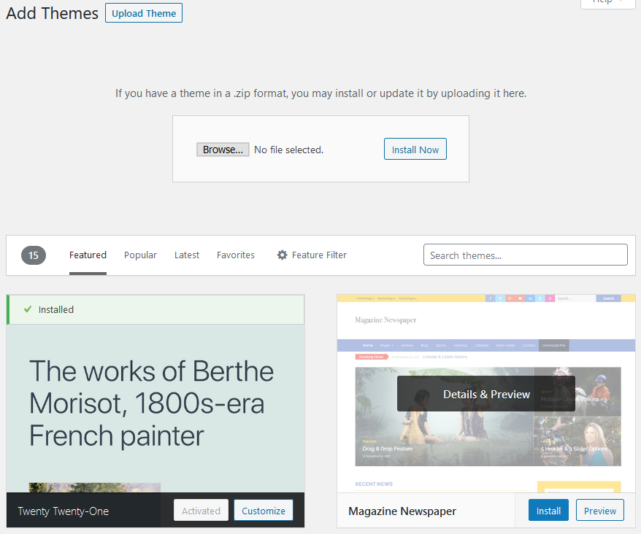
Install WP Themes
A4. Upload your theme
A5. Choose your theme file then click “Install Now” button
OR
B4. Search
B5. Install

Slide 23
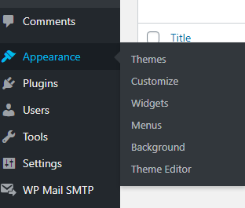
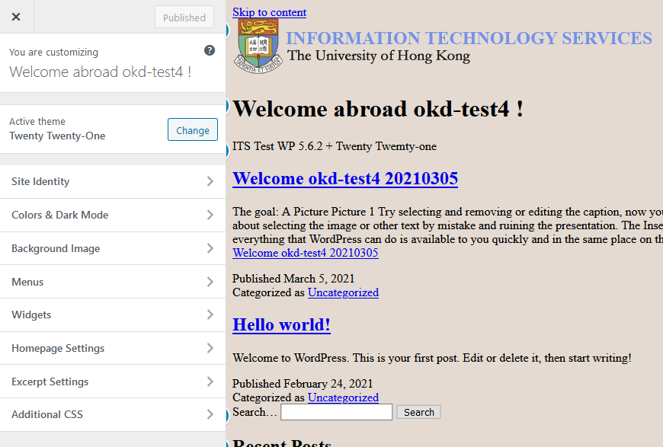
Theme customization
6. “Appearance” -> “Customeize”
7. update

Slide 24
Lab Practices – Install themes
Move your mouse to “Appearance”
Select “Themes”
Click “Add New” button
2. Select Themes
1. Mouse over Appearance
3. Click “Add New”

Slide 25
Lab Practices - Continuous install themes (Two Methods)
4. Select “Upload Theme” (Method 1)
5. Press “Choose File” to select your custom theme
5* Press “Install Now” to install your custom theme.
|
|
|
|
4. Use search function to select the suggested themes by WP (Method 2)
5. Press “Install theme” after found your suitable theme
(Method 1)
4. Select “Upload Theme”
(Method 1)
5. Choose your theme’s file
(Method 1)
Press Install your theme
OR
(Method 2)
4. Use Search function here
(Method 2)
5. Install theme
Go to next page!

Slide 26
6. Select “Appearance”
7. Select “Customize” in pop-up menu
8. Update the theme’s option and layout at left-hand-side menu.
Theme Customization
6. Select “Appearance”
7. Then select “Customize”
8. Update the option and layout by LHS menu
Finish!

Slide 27
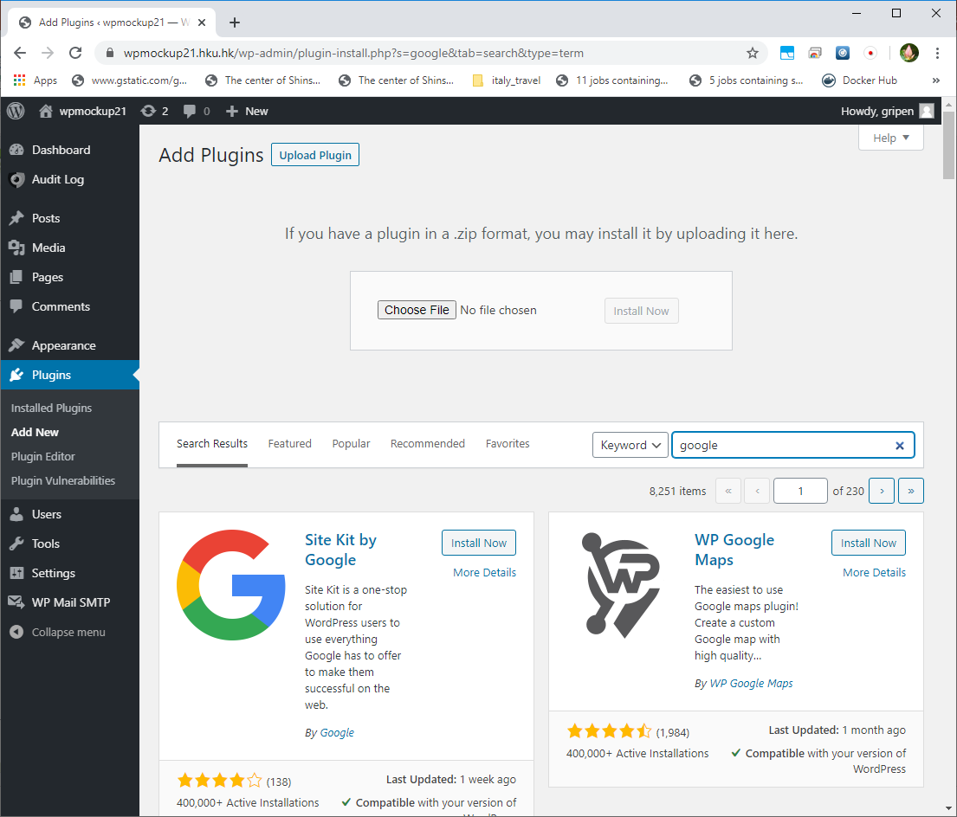
Install WP Plugins
1. Mouse over Plugin and select “Add New”
A2. Upload your plugin
A3. Choose your theme file then click “Install Now” button
OR
B2. Search
B3. Install

Slide 28
Lab Practices – Install Plugins
1. Move your mouse to “Plugins” on main menu and select “Add New”
    2. Upload the Plugins (Method 1) OR Search Plugins by WP (Method 2).
A2. Upload your plugin (Method 1)
A3. Upload your plugin file (Method 1)
OR
B2. Search by WP (Method 2)
1. Mouse over Plugin and select “Add New”
B3. Press “Install Now” once you choose the Plugin
(Method 2)

Slide 29
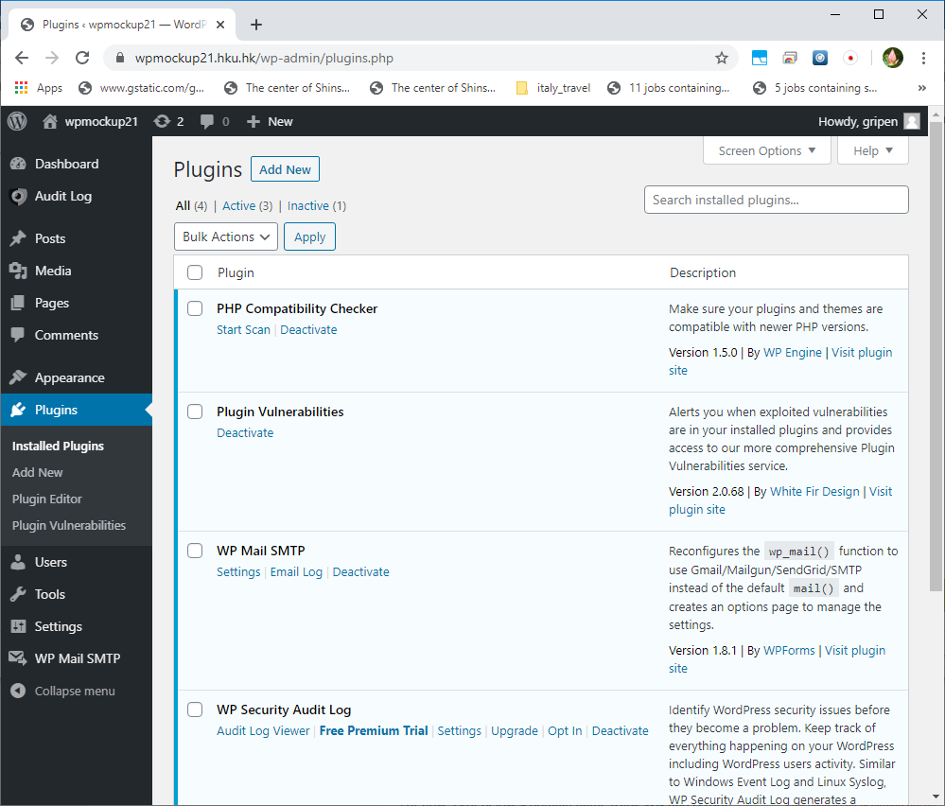
Manage Plugins

Slide 30
Edit page/post

Slide 31
Posts & Pages
Both used for publishing content. You can add text, images, forms, etc.
Posts are blog content listed in a reverse chronological order (newest content on top). You will see posts listed on your blog page.
Pages are static “one-off” type content such as your about page, privacy policy, contact page, etc.
Notes:
Posts vs Pages, post is generally used for blogs and are published at regular intervals while page is used for static articles
Posts are timely vs. Pages are timeless.
Posts are social vs. Pages are NOT.
Posts are organized using categories and tags vs. Pages are hierarchical and can be organized as child and parent pages.
Posts are included in RSS feed vs. Pages are not.
Posts have author and published date vs Pages do not.

Slide 32
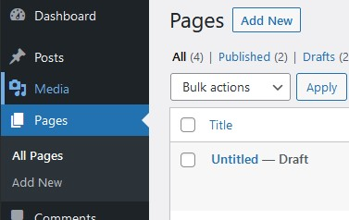
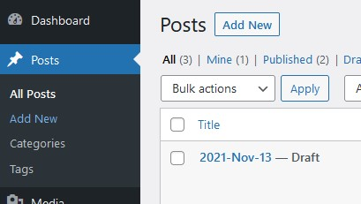
Create new Pages / Posts
A. “Pages” -> “Add New”
B. “Posts” -> “Add New”

Slide 33
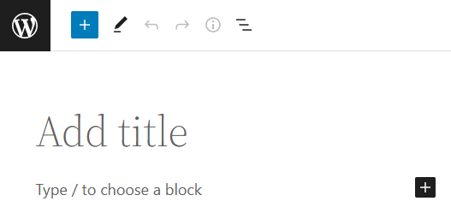
Create new Pages / Posts
The first block of every post or page is the title. It is also used to generate the initial permalink
You can click on the add new block button on the top left corner of the editor, below an existing block, or on the left side of a block
You can click on tabs to browse block categories or type in the keyword to quickly search for a block.
Click “+” to add new block
“Title” block

Slide 34
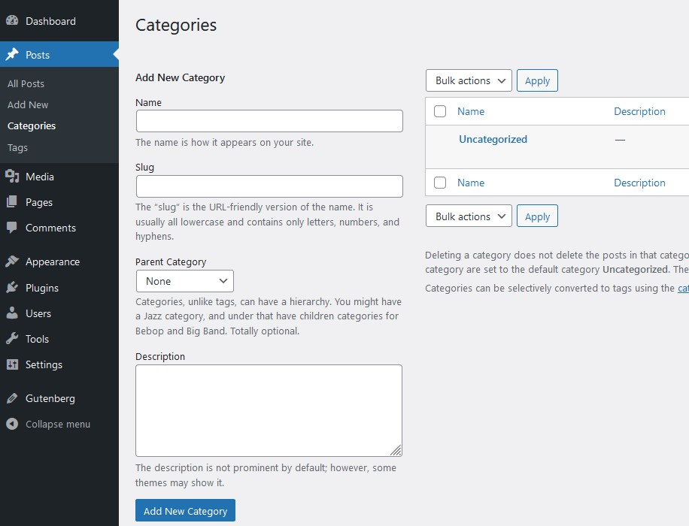
Lab Practices – Add New Categories
1. Move your mouse to “Posts” on main menu
  2. Select “Categories” inside the pulldown menu
    3. Add New Categories.
1. Move on “Posts”
Main menu
2. Select “Categories”
3. Add New Category

Slide 35
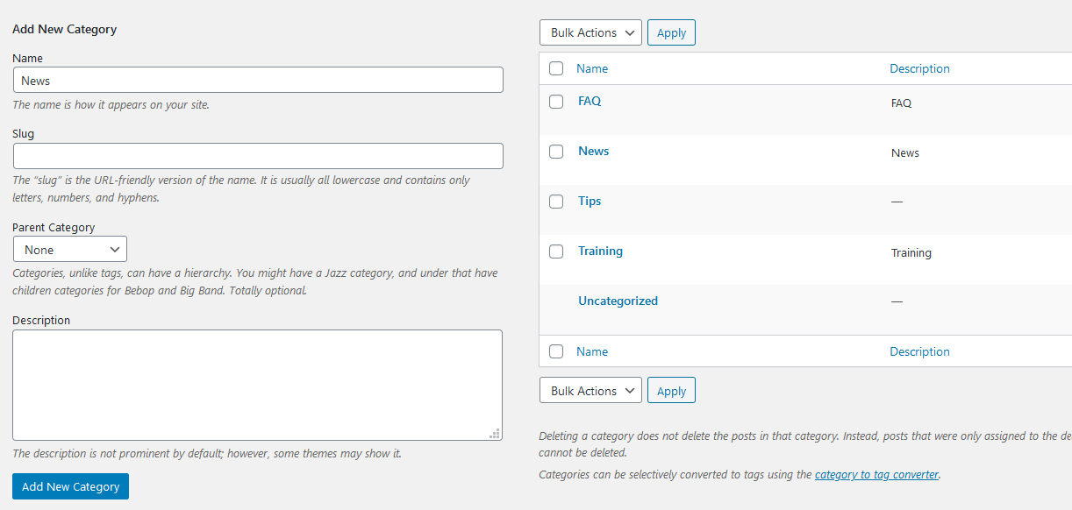
Lab Practices - Continuous Add New Categories
4. Type a new category name here (Any name)
  5. Press a “Add New Category” button
    6. A new category has been created and now you could edit it into this category.
4. Type a new category name here – we use “News” for example
6. A new category “ News” was created
5. Press a “Add New Category” button

Slide 36
Edit Page / Post
You can move blocks up and down by simple drag and drop or by clicking the up and down buttons next to each block.
Each block can also have its own block settings which would appear in the right column of your edit screen.

Slide 37
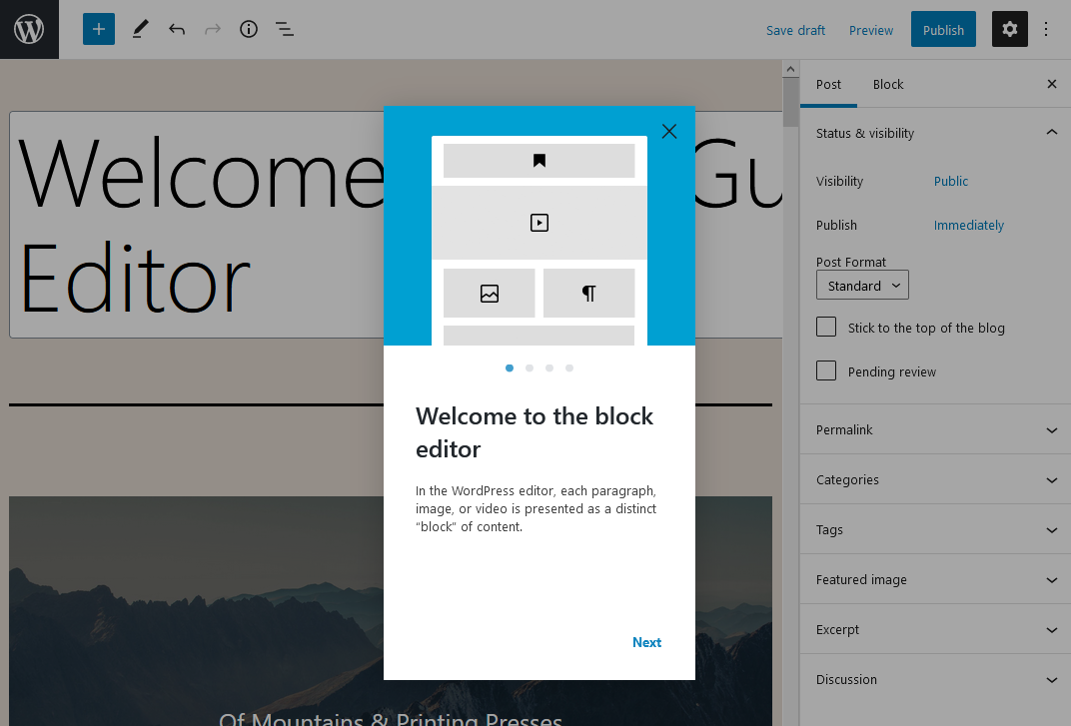
Block Editor (Gutenberg)
Block editor, aka Gutenberg, becomes the default editor since WordPress 5.0
Blocks are content element. You add to the edit screen to create content layouts. Each item you added is a block.
Blocks can be paragraph, images, videos, galleries, audio, lists.
Additional blocks can be added by WP plugins

Slide 38
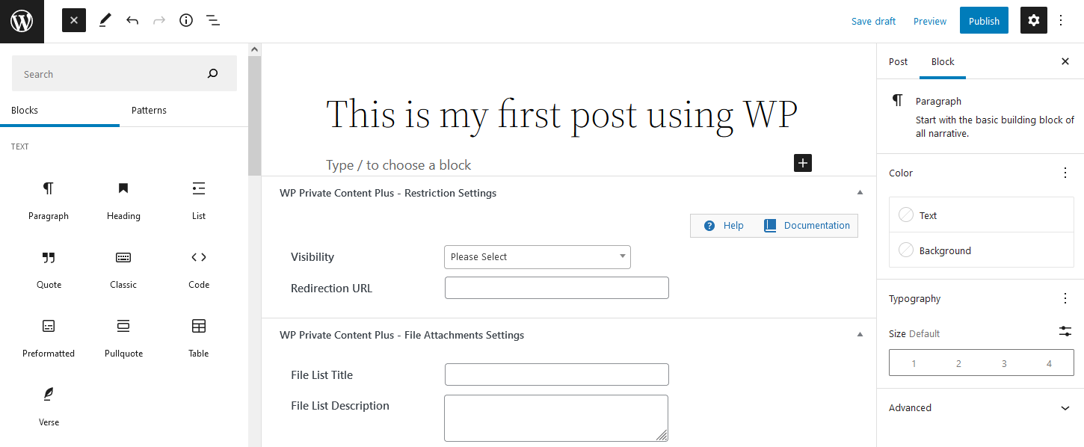
Block editor
Document history, Undo / Redo
Save Draft / Preview / Publish
Title Block (first block)
Post / Block properties
Add different blocks
WP Private Content Plus setting

Slide 39
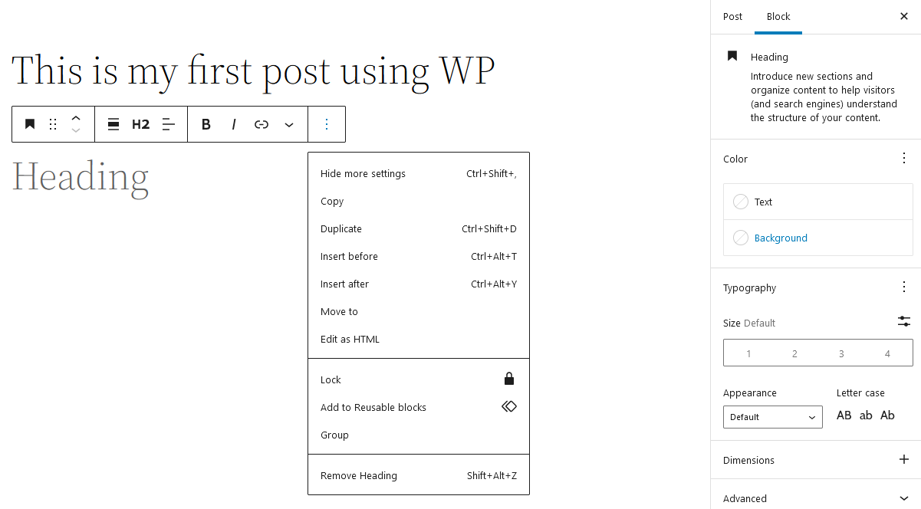
Block editor
Block – Heading properties
New heading
Click on three dots open more settings

Slide 40
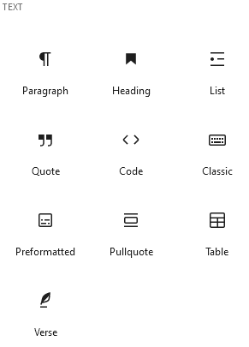
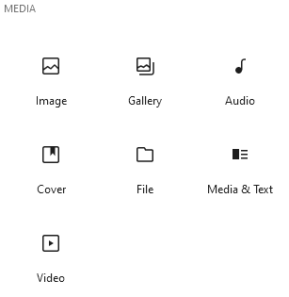
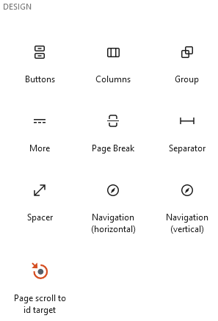
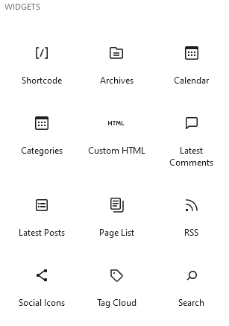
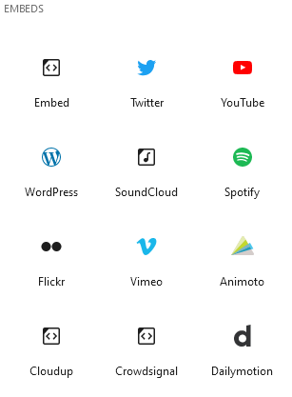
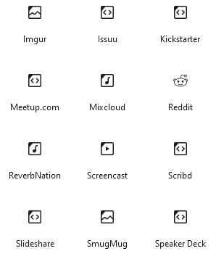
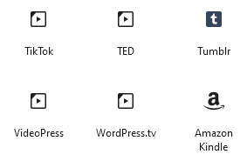
Different type of blocks

Slide 41

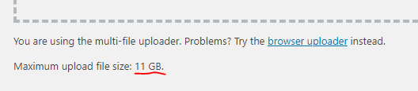
Media
Media includes images, audio, video, and other files.
Under “Media”, tab, you can upload files, manage media, even simple image editing
Even you can check how many disk space is available

Slide 42
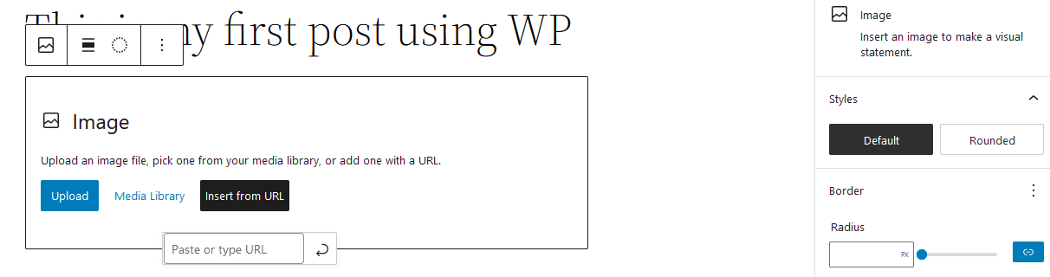
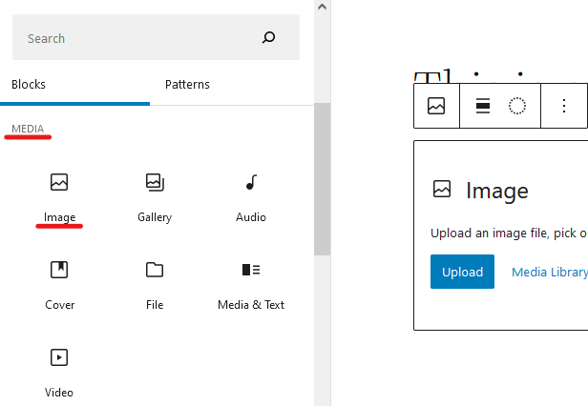
Media
Insert the embedded media record by Media Library or URL

Slide 43
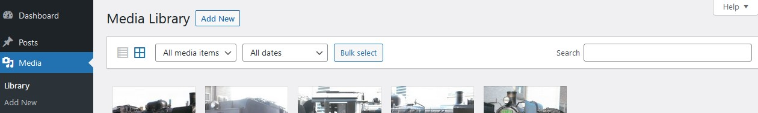
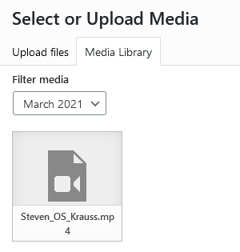
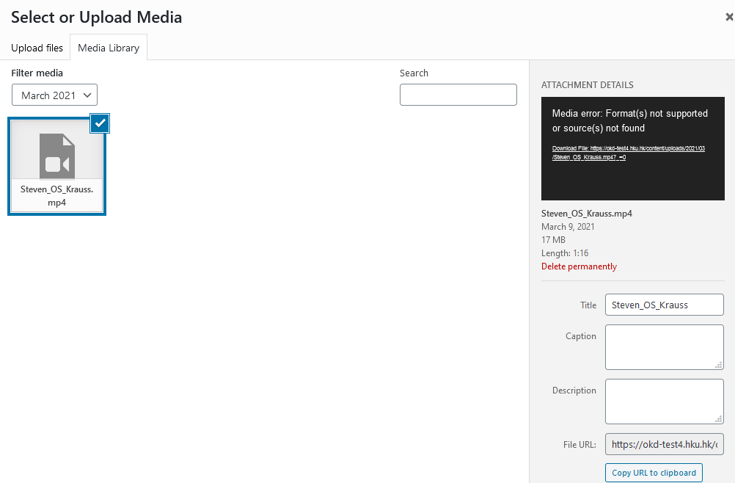
Media

Slide 44
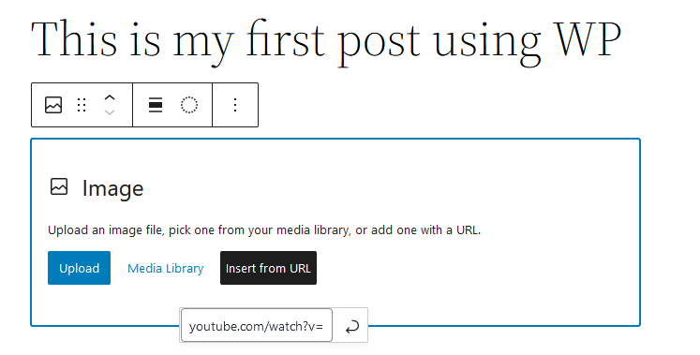
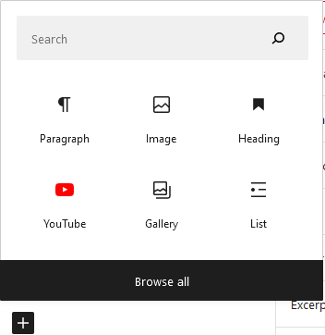
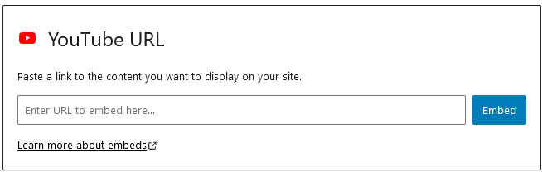
Media
Insert the embedded media record by YouTube URL

Slide 45
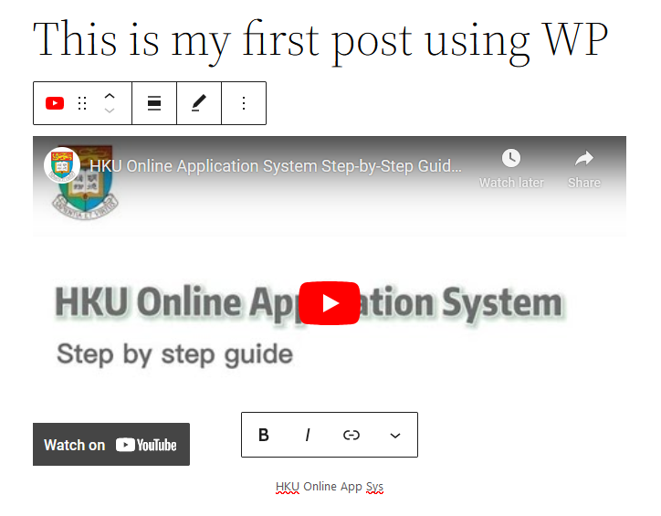
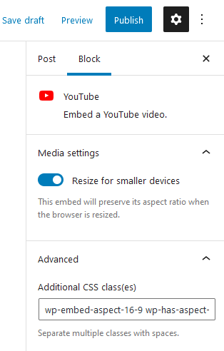
Media
Insert the embedded media record by YouTube URL

Slide 46
Menu (For Themes Twenty Twenty-One)
Navigation menu is a list of a links pointing to important areas of a website.
Navigation menus give your site structure and help visitors find what they’re looking for.
The exact location of your menu will depend on your WordPress theme. Most themes will have several options, so you can create different menus that can be displayed in different places.
Most WordPress themes come with a primary menu that appears on the top
Notes:
A navigation menu is a list of a links pointing to important areas of a website. They are usually presented as a horizontal bar of links at the top of every page on a website.
The exact location of your menu will depend on your WordPress theme. Most themes will have several options, so you can create different menus that can be displayed in different places.
For instance, most WordPress themes come with a primary menu that appears on the top. Some themes may include a secondary menu, a footer menu, or a mobile navigation menu as well.

Slide 47
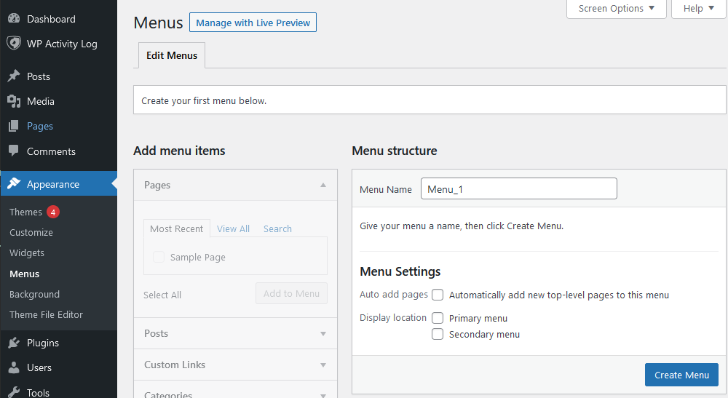
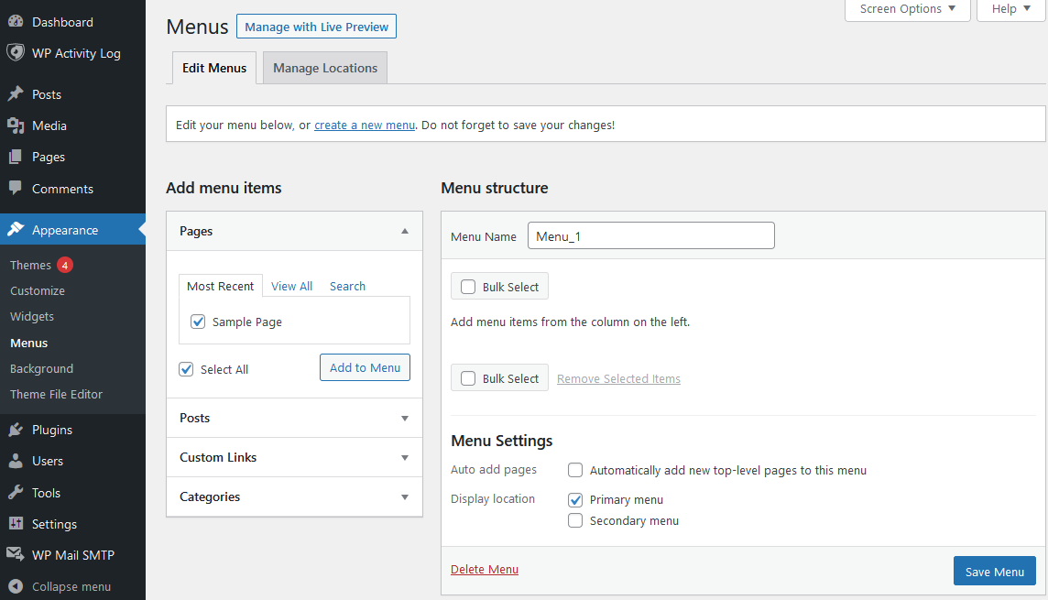
Create Menus
(For Themes Twenty Twenty-One)
Create a new menu
Select a menu to edit it
Save created new menu
Select “Menus”
Go to Appearance
Select the menu items which you want to add in menu
Select the menu’s display location

Slide 48
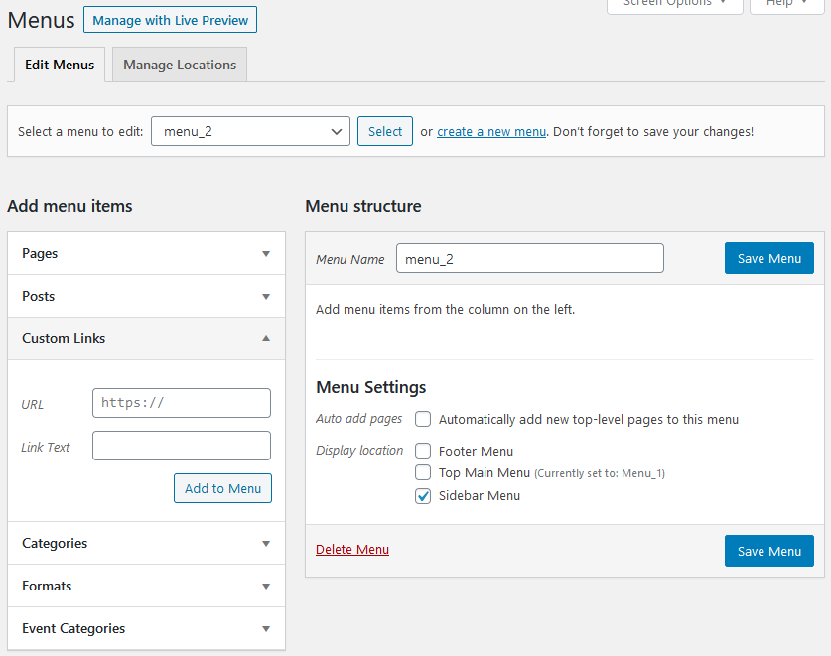

Create Menus
(For Themes Twenty Twenty-One)
Select a menu to delete it
In Menus
The Menu has been successfully deleted
Delete Menu

Slide 49
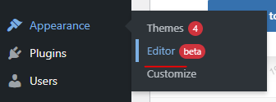
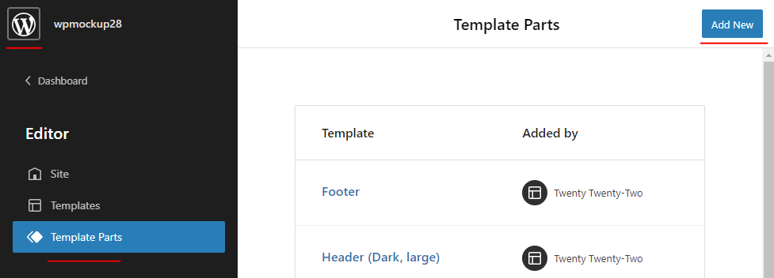
Create Menus
(For Themes Twenty Twenty-Two)
WordPress theme “Twenty Twenty-Two” does not have a menu system included into the theme’s section anymore. So, editor needs to access the page template and work custom menu from there.
Create a new template:
> 1 Go to themes, then
>> 2 Go to editor, then
>>> 3 Go to the “Template Parts” page
>>>> 4 Click “Add New”
Editor
Add New
Template Parts

Slide 50
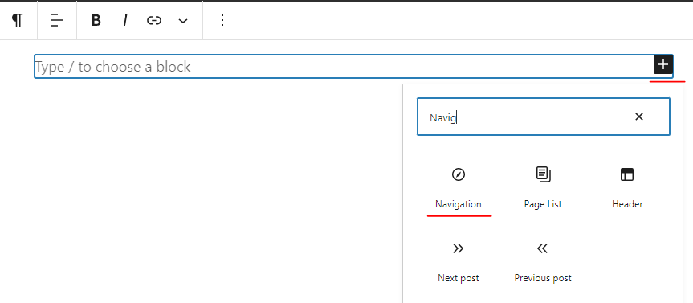
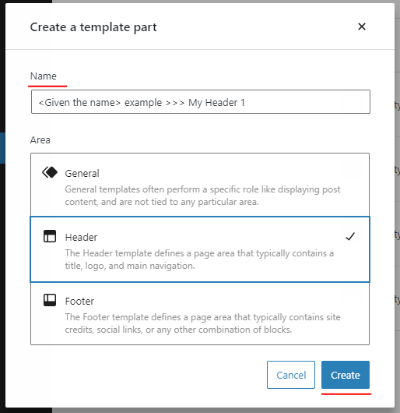
Create Menus
(For Themes Twenty Twenty-Two)
Create a “New template part” and given a name, then
>> 5 Create a new custom template, press “Create”
>>> 6 Press “+” and “Navigation”
>>>> 7 Press “Start empty”
Add
Navigation
Create

Slide 51
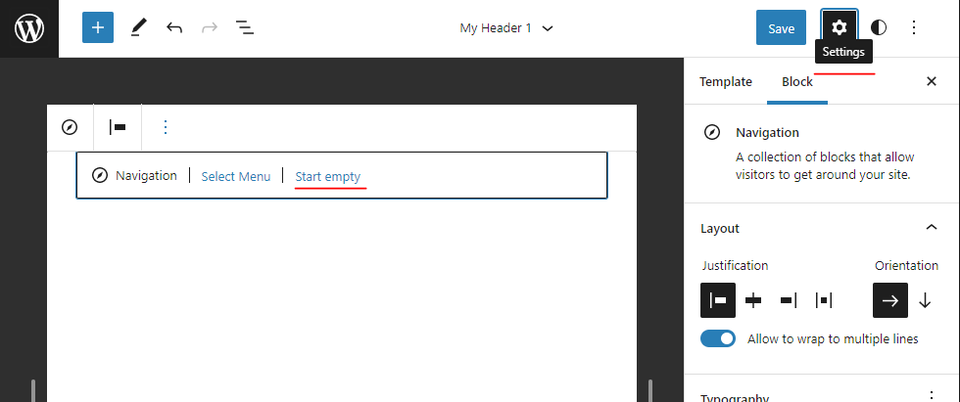
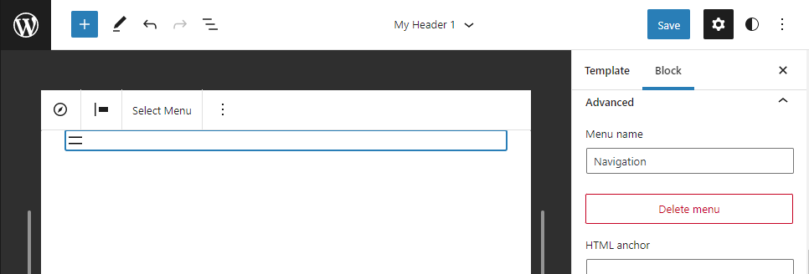
Create Menus
(For Themes Twenty Twenty-Two)
Press Start Empty
** Press “Settings” to pop-up the detailed menu with advanced features
Delete Menu
(If necessary)

Slide 52

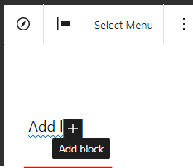
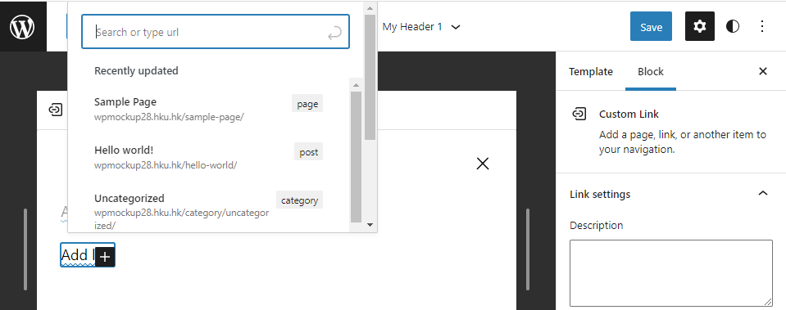
Create Menus
(For Themes Twenty Twenty-Two)
Add template part to a page:
> 8 Press “Add +” the menu items to add blocks.
>> 9 Two adding options: Home / Page format OR Home / URL format
Select option
Create a new menu block
Search / Select your edited items inside this pop-up window (page, post, URL) then add your first item into a new menu block

Slide 53
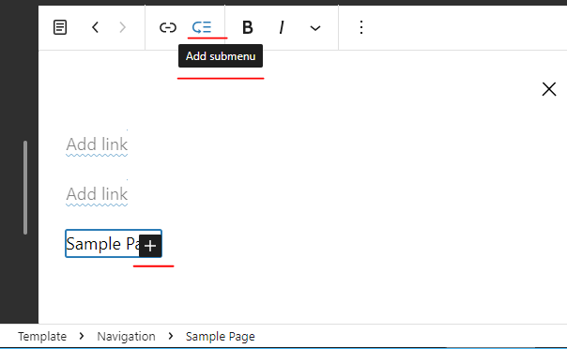

Create Menus
(For Themes Twenty Twenty-Two)
Menu Patterns:
For this example – Create custom pages and add more
> 10 Select the preloaded pages from web and linking it to this custom block in this case
>> 11 Add the sub-menu items by link / page as well
Once finished your custom editing, save this template.
Add a sub-menu
Build a new sub-menu item under main item

Slide 54

Create Menus
(For Themes Twenty Twenty-Two)
If you want to add this custom template to your page,
> Select “page” panel on the right side
>> Check “Template: <Your Page>”
>>> Click “Edit”
Drag-and-Drop “Template Part” from the left side panel to your page
> Select “Choose existing” in Template Part
>> Add the custom template part in a header template part of the page
You can save this editing finally and publish you page.
Example:

Slide 55

Lab Practices – Create Menus under Theme “Twenty-Twenty-One”
1. Move your mouse to “Appearance” on main menu
2. Select “Menus” inside the pulldown menu
3. Click “Create a new menu”
Main menu
3. Click “Create a new menu”
1. Go to Appearance
2. Select “Menus”

Slide 56

Continuous - Lab Practices – Create Menus under Theme “Twenty-Twenty-One”
4. Give a new menu name (For example – put a new menu name – menu_2)
  5. Click “Create Menu” button
In Menus
5. Click Create Menu
4. Give a new menu name

Slide 57
Continuous Lab Practices – Create Menus under Theme “Twenty-Twenty-One”
6. Select a menu to edit it (For example – menu_2)
  7. Select the menu items which you want to add in menu
  8 & 9. Select the menu’s display location. Press “Save Menu” button to save your settings.
In Menus
6. Select a menu to edit it
7. Select the menu items which you want to add in menu
Add menu items from the column on the left
9. Save Menu
8. Select the menu’s display location

Slide 58
(Optional) Lab Practices – Delete Menus under Theme “Twenty-Twenty-One”
1. Select a menu to delete it
  2. Click “Delete Menu” link to delete the unnecessary menu.
In Menus
1. Select a menu to delete it
The Menu has been successfully deleted
2. Click “Delete Menu”

Slide 59

Configure WP settings
Settings menu
1. Select “Settings” in main menu at the left-hand side
2. Click Setting items

Slide 60

Configure WP settings
Settings menu
1. Select Setting items
2. Config your options and press “Save Changes” to complete

Slide 61


Block List View
WordPress Block Builder
Gutenberg list view is being called after WP 5.8
Previous – pop-up view window only;
Now – full list view window available.

Slide 62

Block List View
1 Click “Group”;
2 Click “Block” and put the name / title inside the field of “HTML anchor”;
3 “History” will be put on right next to the Group in List View. You can put a HTML anchor into all of these various settings easily and make it easy when editor is looking in the list view.

Slide 63



Heading
You can go into this list view then you can see that there are many layers (= columns) inside the list under each heading. You can edit the content or change the properties inside each column or group column, when you go into the next layer underneath at the column.
Step 1 – Click “+” and then select “Heading”
Step 3 – Headings created in each group
Step 2 – Edit “Heading” to your text

Slide 64

Pattern Directory
It is a design library, and this is actually a page WordPress.org/patterns/. This is going to be a public library or directory of patterns that use the default WordPress Block Builder blocks, so these materials can use on every single website. You will be able to come to the pattern and click on “copy” button at lower right corner, and then paste that design into your website. You can also copy and paste the site to another site easily with the block builder.

Slide 65


Pattern Directory
Drag-and-drop your selected pattern
Hold your button on the selected pattern under “Patterns” and then “drag-and-drop” this pattern from the left panel to the editing page.

Slide 66


Pattern Directory
Apply Duotone Filter
(color effect)
Another enhanced feature is color editing to original images. You can see that there is a “circle” icon (Apply Duotone Filter) in the toolbar. When you are click this icon, it is going to show up the color effect here.

Slide 67




PDF Viewer
    You can embed a PDF document on your webpage easily. There is an option to give the audience to download the PDF document and printed as PDF format of one of the websites.
Step 1
Step 2
Step 3
Step 4

Slide 68


PDF Viewer
If you go to the right and show the options, here are some options such as control the height of the viewer display; Show the download button to offer for viewer the document download.
Click on view page and you can scroll through the PDF document inside the webpage. Just click a download button to download document. A toolbar is available for selecting different pages in pdf, provides the zoom button of the viewing size and printing all kind of contents in it.

Slide 69

Reusable Block Flow
Going to choose this container in the toolbar, click “three dots” then select “Add to Reusable blocks”.

Slide 70




Reusable Block Flow
Just given the name into the name field and then click on “Save” button.

Slide 71



Reusable Block Flow
When you click on “Save draft” and then click “Publish”, you have made a change to the reusable block and it is going to make a change there as well, and that is going to change across your website.

Slide 72
Create SSO-protected pages

Slide 73
Create SSO-protected pages/posts
Use the Plugin “WP Private Content Plus”
For each page / post, under the “Restriction Settings” of “WP Private Content Plus“, in “Redirection URL“ dialog, enter “/wp-login.php?redirect_to=/PERMALINK/“, e.g.: “/wp-login.php?redirect_to=/how-to-create-page-required-portal-login/”
Select the “Visibility” that matches your need

Slide 74



SSO-protected page/post
2A. All users
2B. Specified type of users
2C. Specified users
1. Redirection URL

Slide 75
SSO-protected attachments
Use the Plugin “WP Private Content Plus”
For each page / post, under the “Manage file attachment” of “WP Private Content Plus“, click “Add files” to upload / select attachment.
Select both “Visibility” and “Download” to “Members”
The generated attachment URL will not be usual “/uploads/XXXXX” URL pattern and required login.

Slide 76

SSO-protected files
2. Visibility: “Members”
1. Add Files
3. Download Permission: “Members”

Slide 77
Support services
Online documentation
https://wpcms-its.hku.hk
https://wordpress.org/support/
Support email:
wpcms@hku.hk

Slide 78

Q & A
Any Question?
Send your feedback from below evaluation form
https://hku.au1.qualtrics.com/jfe/form/SV_0lbNva5wxUSTS62

Slide 79
Thank you

